Slide 1

Exploring the Power of Inheritance in Object-Oriented Programming with Java
Presented by
Name – Aditya Kumar
Roll No. – 34230821034
Dept. – CSE(AI & ML)
3rd year (5th semester)
Future Institute of Technology

Slide 2
1. Introduction to Inheritance
Inheritance in Java is a mechanism in which one object acquires all the properties and behaviors of a parent object. It is an important part of OOPs (Object Oriented programming system).
The idea behind inheritance in Java is that you can create new classes that are built upon existing classes. When you inherit from an existing class, you can reuse methods and fields of the parent class. Moreover, you can add new methods and fields in your current class also.
Inheritance represents the IS-A relationship which is also known as a parent-child relationship(Whenever one class inherits another class, it is called an IS-A relationship).
Aditya Kumar,34

Slide 3
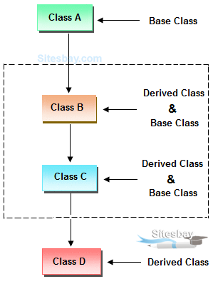
2.Terms used in Inheritance
Class: A class is a group of objects which have common properties. It is a template or blueprint from which objects are created.
Sub Class/Child Class: Subclass is a class which inherits the other class. It is also called a derived class, extended class, or child class.
Super Class/Parent Class: Super class is the class from where a subclass inherits the features. It is also called a base class or a parent class.
Reusability: As the name specifies, reusability is a mechanism which facilitates you to reuse the fields and methods of the existing class when you create a new class. You can use the same fields and methods already defined in the previous class.
Aditya Kumar,34

Slide 4
3.The syntax of Java Inheritance
Class subclass-name extends superclass-name
{
variables declaration;
methods declaration;
}
The extends keyword indicates that you are making a new class that derives from an existing class. The meaning of "extends" is to increase the functionality.
Why Do We Need Java Inheritance?
Code Reusability: The code written in the Superclass is common to all subclasses. Child classes can directly use the parent class code.
Method Overriding: Method Overriding is achievable only through Inheritance. It is one of the ways by which Java achieves Run Time Polymorphism.
Abstraction: The concept of abstract where we do not have to provide all details is achieved through inheritance. Abstraction only shows the functionality to the user.
Aditya Kumar,34

Slide 5
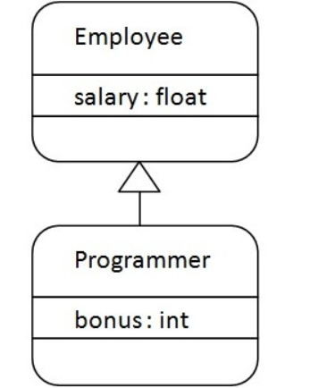
4. Java Inheritance Example
SOURCE CODE:-
class Employee{
float salary=40000;
}
class Programmer extends Employee{
int bonus=10000;
public static void main(String args[]){
Programmer p=new Programmer();
System.out.println("Programmer salary is:"+p.salary);
System.out.println("Bonus of Programmer is:"+p.bonus);
}
}
As displayed in the above figure, Programmer is the subclass and Employee is the superclass. The relationship between the two classes is Programmer IS-A Employee. It means that Programmer is a type of Employee.
OUTPUT :-
Programmer salary is:40000.0
Bonus of programmer is:10000
Aditya Kumar,34

Slide 6
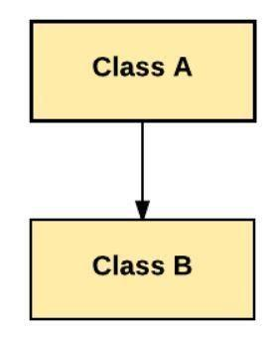
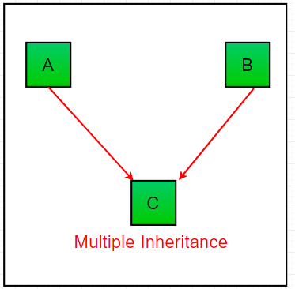
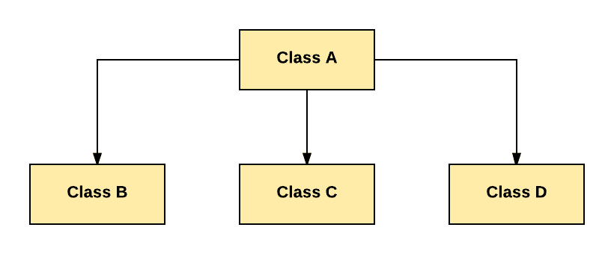
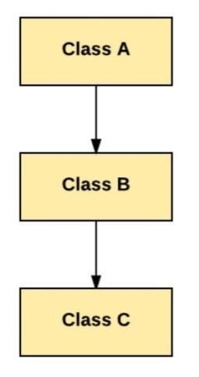
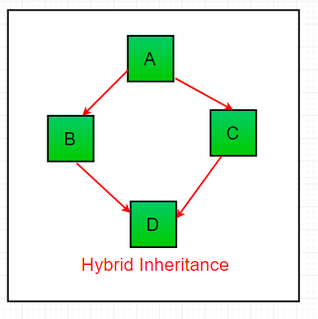
5. Types of Inheritance in Java
1. Single Inheritance (only one super class)
2. Multiple Inheritance ( several super classes)
3. Hierarchical Inheritance ( one super class, many subclasses)
4. Multilevel Inheritance (derived from a derived class)
5. Hybrid Inheritance ( a type of inheritance where a class extends two or more classes, where one or more of them is a combination of different types of inheritance).
Aditya Kumar,34

Slide 7
6. Conclusion
Inheritance is a fundamental concept in OOP using Java. It promotes code reuse, enhances modularity. By understanding and leveraging inheritance, developers can create robust and flexible software solutions. This slide summarizes the key takeaways from this presentation.
THANK YOU!
Aditya Kumar,34

